Slide 1
AWS Services and their Pricing
By :
AKHIL K P
ARUN KUMAR V S
VECHAM SANDEEP

Slide 2
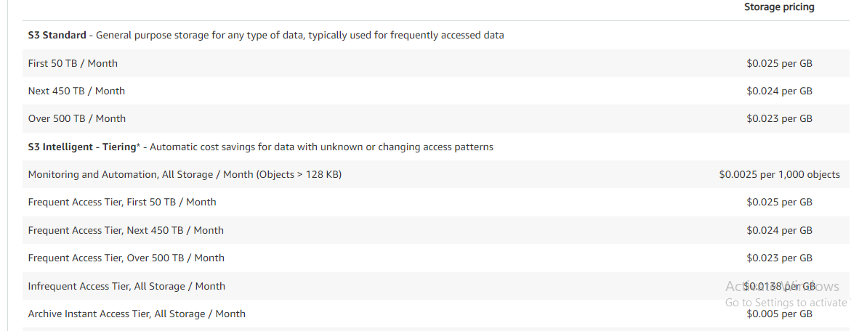
1. S3- simple storage service
Amazon Simple Storage Service (Amazon S3) is an object storage service that offers industry-leading scalability, data availability, security, and performance. You can use Amazon S3 to store and retrieve any amount of data at any time, from anywhere.

Slide 3
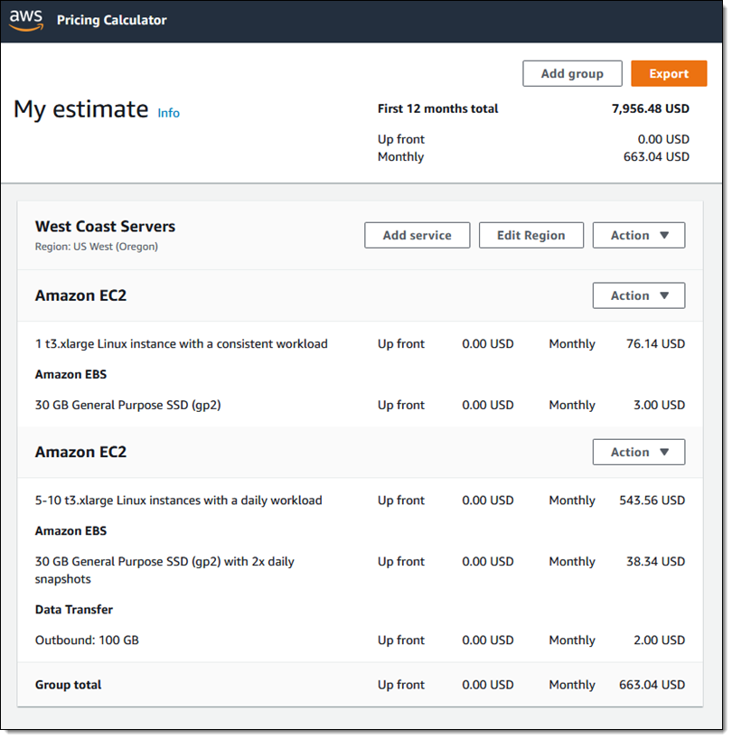
2. EC2 – Elastic Compute Cloud
Amazon Elastic Compute Cloud (Amazon EC2) is a web service that provides secure, resizable compute capacity in the cloud. It is designed to make web-scale cloud computing easier for developers. Amazon EC2's simple web service interface allows you to obtain and configure capacity with minimal friction.

Slide 4
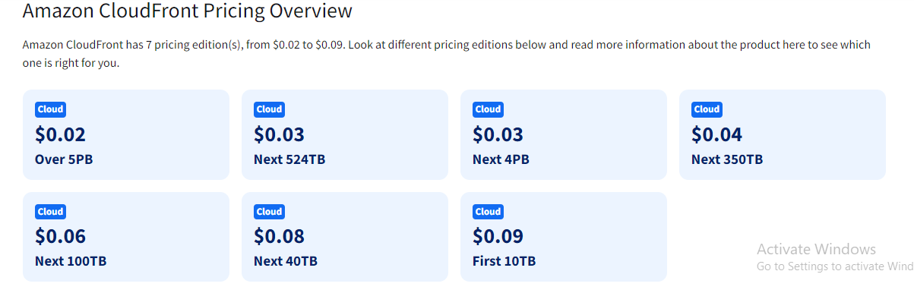
3. Cloud front
Amazon CloudFront is a web service that speeds up distribution of your static and dynamic web content, such as . html, . css, . js, and image files, to your users. CloudFront delivers your content through a worldwide network of data centers called edge locations.

Slide 5
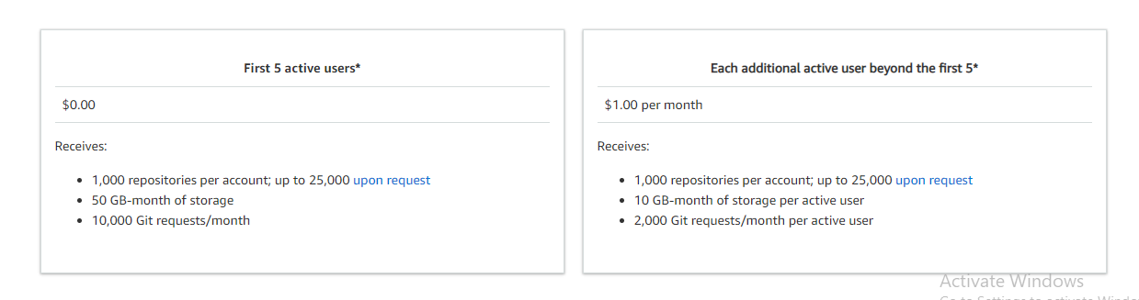
4. Code commit
Anyone with an AWS account can get started with AWS Code Commit for free. Your account gets 5 active users per month for free (within limits), after which you pay $1.00 per additional active user per month. There are no upfront fees or commitments.

Slide 6

5. IAM (Identity and Access Management)
AWS Identity and Access Management (IAM) and AWS Security Token Service (AWS STS) are features of your AWS account offered at no additional charge. You are charged only when you access other AWS services using your IAM users or AWS STS temporary security credentials.

Slide 7
To Check price of other services
Checkout the aws price calculator :
https://calculator.aws/#/

Slide 8


